Slide 1


FINANCE TRACKER
A PERFECT FINANCE BUDDY
Website
APRIL 2025
www.financetracker.in

Slide 2

TABLE OF CONTENT
A PERFECT FINANCE BUDDY
01
04
Login/SignUp page
Visual Chart
02
05
Add Transaction / Summary
Analysis & Tips
03
06
Transaction History
Technology Used
Finance Tracker

Slide 3
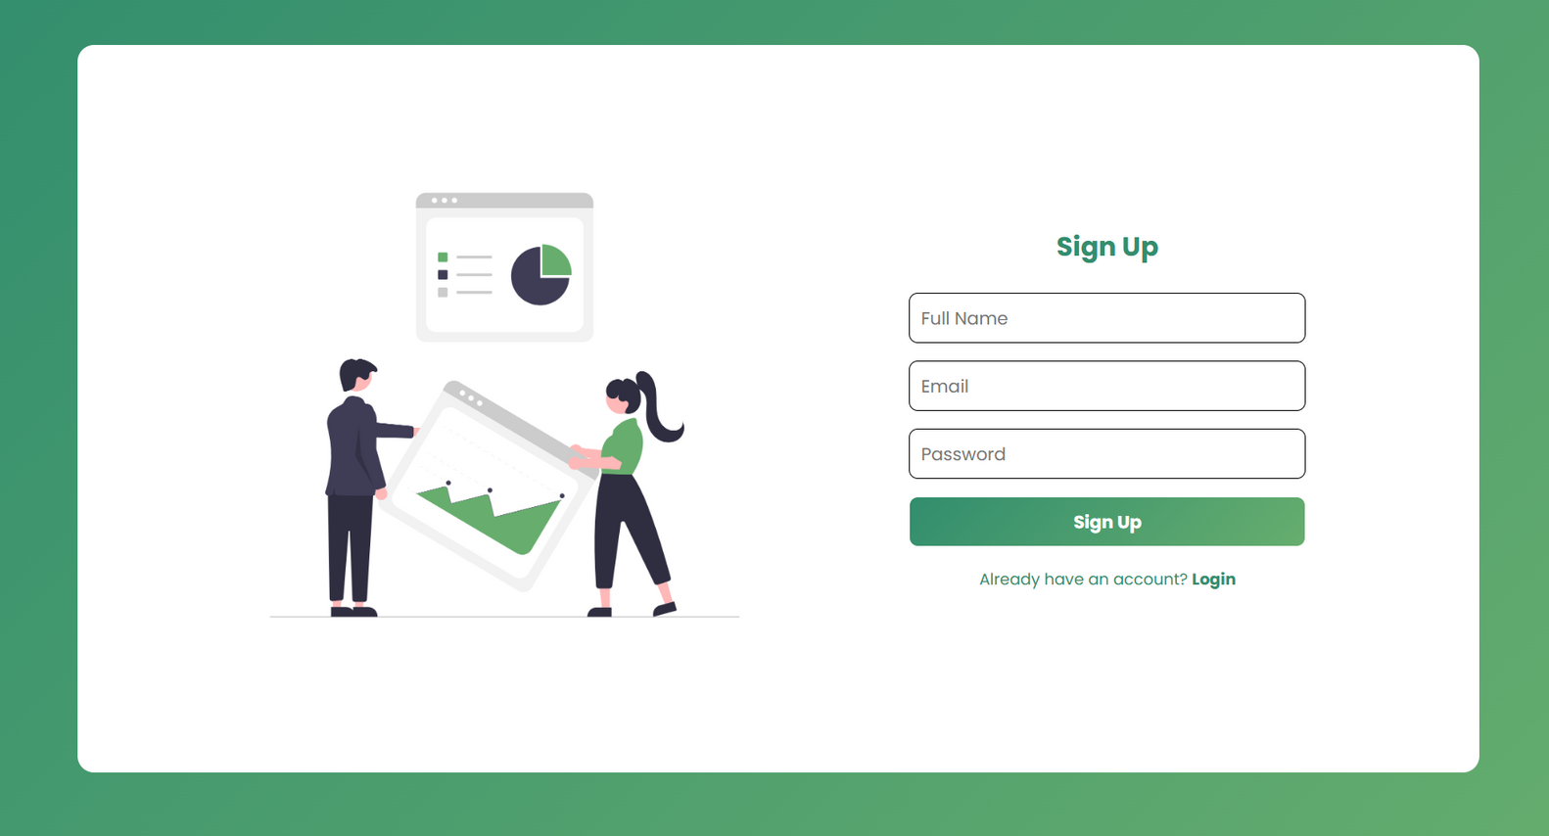
LOGIN / SIGNUP
FINANCE TRACKER
Navigate to "Sign Up," complete fields like name, email, password. Click sign-up. Log in using credentials to securely access your profile/dashboard for a seamless user experience.

Slide 4

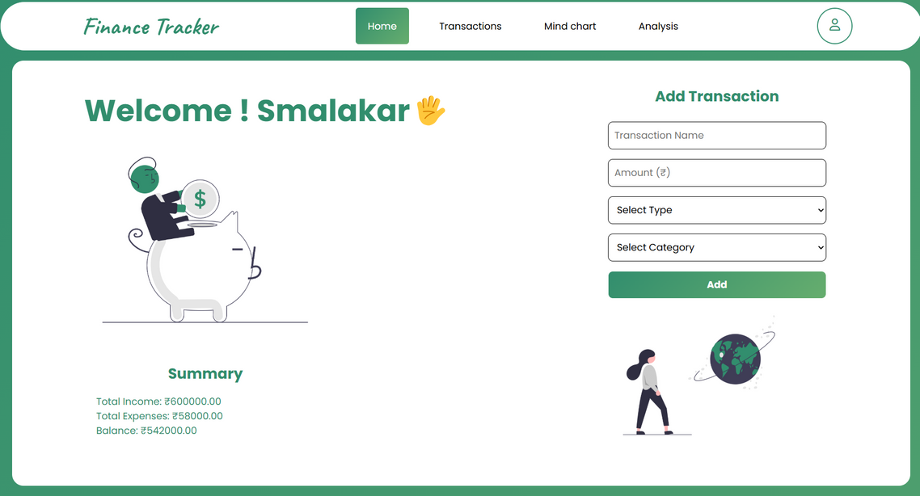
ADD TRANSACTION
SUMMARY OF YOUR BUDGET
The "Add Transaction" page simplifies finance management with dropdown categories, detailed input fields, and summary breakdowns, ensuring organized tracking and insightful analysis of users' income and expenses.

Slide 5

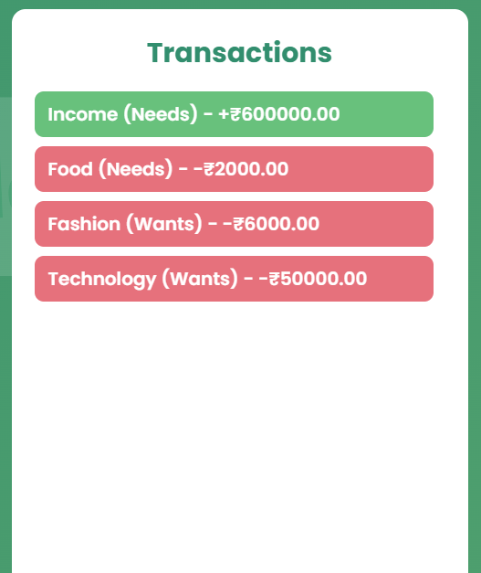
TRANSACTION
HISTORY
Track all your transactions effortlessly in one place by organizing income, expenses, and savings. Gain financial clarity with categorized summaries, monitor spending trends, and manage your finances efficiently and transparently.

Slide 6
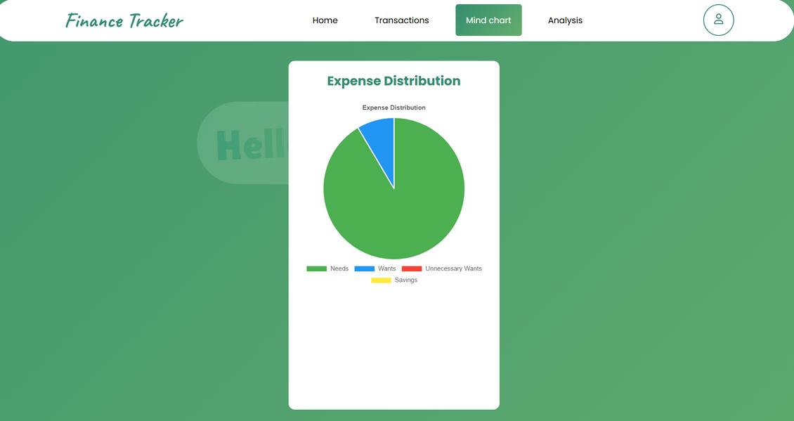

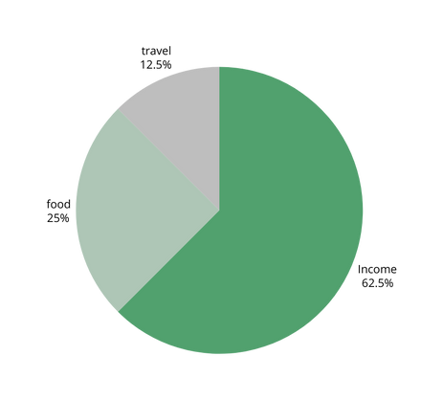
VISUAL CHART
SUMMARY OF YOUR BUDGET
Visual charts like pie charts simplify budget analysis by illustrating financial distribution. Tools like Chart.js enhance clarity, interactivity, and insights, making comparisons and tracking patterns easier for effective financial management.

Slide 7
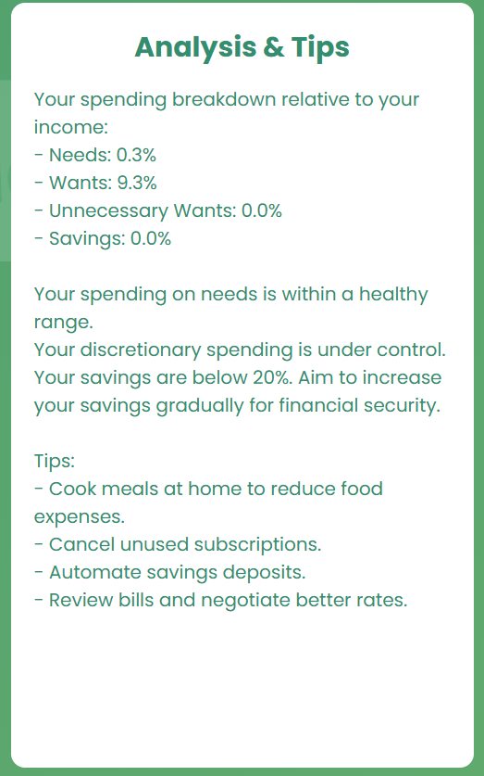
ANALYSIS & TIPS
FINANCE TRACKER
The "Analysis and Tips" section offers insights to reduce expenses, boost savings, ensure balanced budgeting, and empower users to achieve financial goals confidently based on their transaction history and practical suggestions.

Slide 8




TECHNOLOGY USED
financeTracker
HTML builds the app's foundational structure, organizing content and elements, while vanilla CSS styles the application, adding colors, layouts, and responsiveness to create a visually engaging and functional design.
JavaScript is utilized to handle various tasks like form validation, user interactions, and event handling, while efficiently managing data through APIs, local storage, and real-time updates for seamless functionality.
Local Storage is used to store data in a user's browser persistently, allowing quick access to information like user preferences or session details without needing server-side requests. Chart.js to create pie chart.
Javascript
Local Storage / Js Libraries
HTML / CSS

Slide 9
DEVELOPERS
TEAM - SYNTAX
SUPRIYO MALAKAR ( DEVELOPER )
MOHIT PANDEY ( DEVELOPER )
ALOK KUMAR ( DESIGNER )
JAYANTA BHATTACHARJEE ( DESIGNER )
MOHIT GUPTA ( DESIGNER )
LIVE DEMO OF WEBSITE : Click here

Slide 10
Finance Tracker
THANK YOU
A PERFECT FINANCE BUDDY
Website
APRIL 2025
www.financetracker.in

